Slide 1
1

Slide 2

APPLIED CRYPTOGRAPHY
Lecture 40
2

Slide 3
Zero knowledge proof
One party can prove to another party that they know a value
3

Slide 4
To distinguish between message authentication and entity authentication
To define witnesses used for identification
To introduce some zero-knowledge protocols for entity authentication

Slide 5
Entity authentication
Entity authentication is a technique designed to let one party prove the identity of another party. An entity can be a person, a process, a client, or a server. The entity whose identity needs to be proved is called the claimant; the party that tries to prove the identity of the claimant is called the verifier.
Methods entity authentication:
Using a password
Challenge-response protocols
Zero-knowledge protocols

Slide 6
Message vs Entity authentication
Message authentication might not happen in real time; entity authentication does.
Message authentication simply authenticates one message; the process needs to be repeated for each new message. Entity authentication authenticates the claimant for the entire duration of a session.

Slide 7
Verification Categories
Something known
Something possessed
Something inherent

Slide 8
PASSWORDS
The simplest and oldest method of entity authentication is the password-based authentication, where the password is something that the claimant knows.
Fixed Password
One-Time Password

Slide 9
CHALLENGE-RESPONSE
In password authentication, the claimant proves her identity by demonstrating that she knows a secret, the password. In challenge-response authentication, the claimant proves that she knows a secret without sending it.
Using a Symmetric-Key Cipher
Using Keyed-Hash Functions
Using an Asymmetric-Key Cipher
Using Digital Signature

Slide 10
ZERO-KNOWLEDGE
In zero-knowledge authentication, the claimant does not reveal anything that might endanger the confidentiality of the secret. The claimant proves to the verifier that she knows a secret, without revealing it. The interactions are so designed that they cannot lead to revealing or guessing the secret.
Types
Fiat-Shamir Protocol
Feige-Fiat-Shamir Protocol
Guillou-Quisquater Protocol

Slide 11
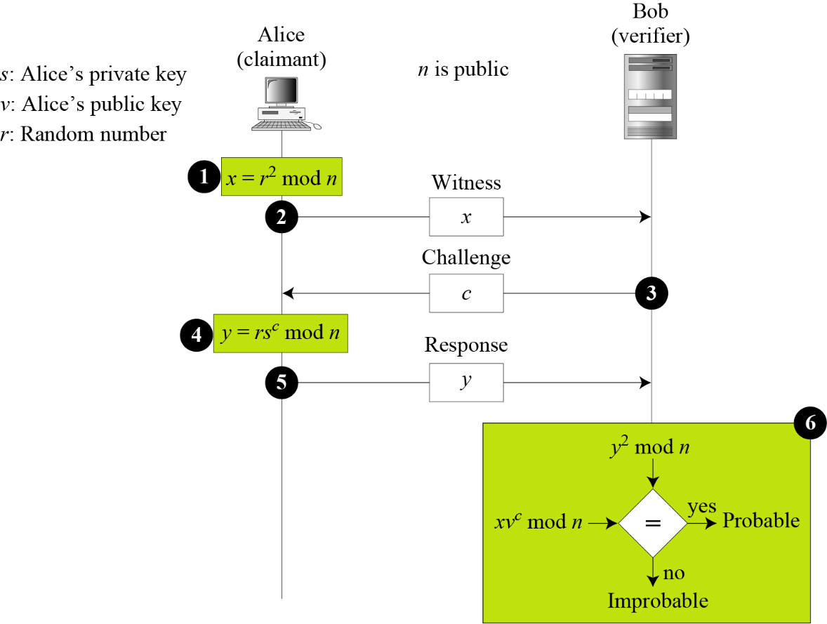
Fiat-Shamir protocol

Slide 12
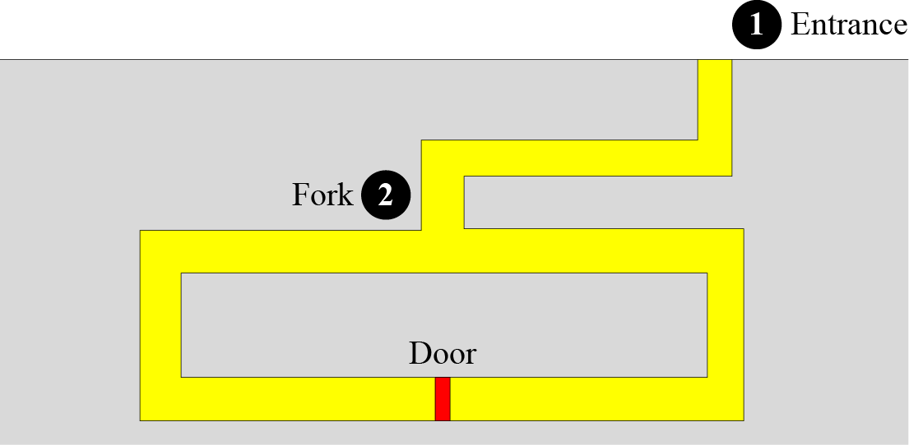
Cave Example
Cave example

Slide 13
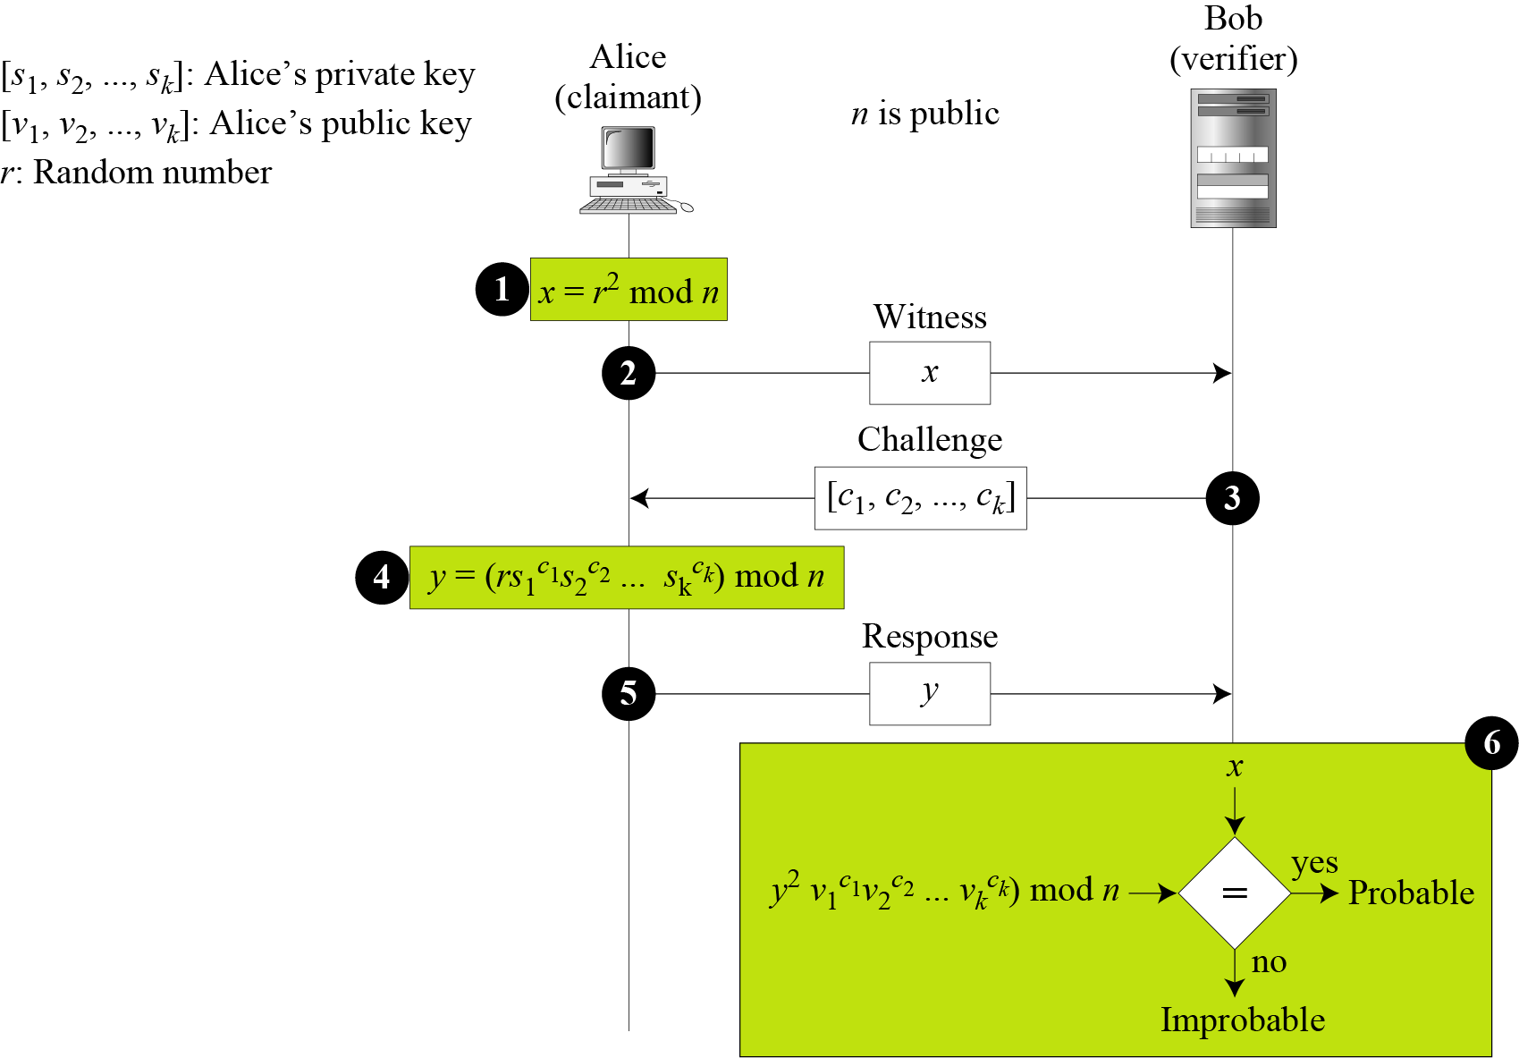
Feige-Fiat-Shamir protocol

Slide 14
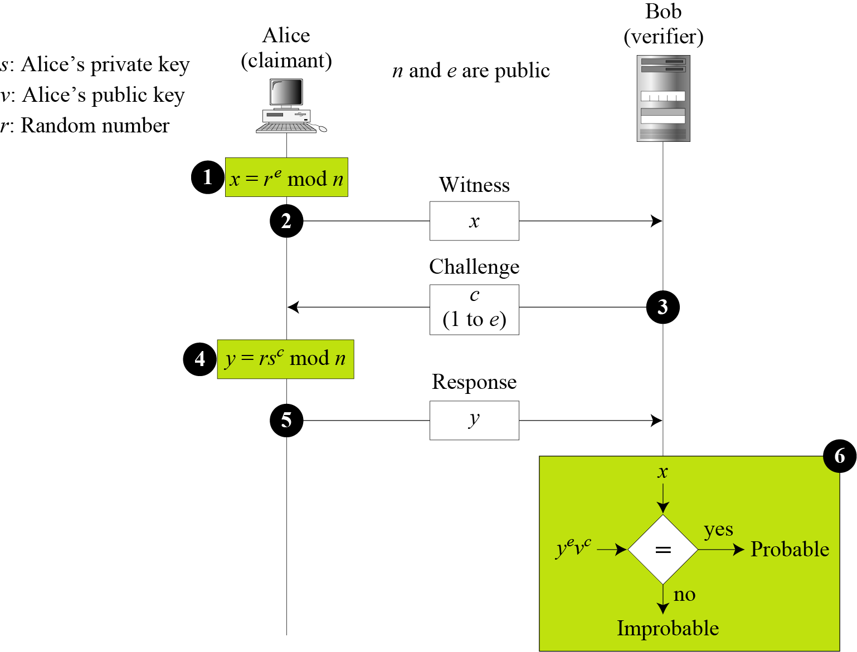
Guillou-Quisquater protocol

Slide 15
Thank You!
Next Class
Mandatory reading for the next class
https://courses.csail.mit.edu/6.857/2019/project/18-doNascimento-Kumari-Ganesan.pdf
10 June 2020
15

Slide 16


Rajashree S
Computer Science and Engineering
PES University, Bengaluru
10 June 2020
16

